Slide 1
Data Structures
Lecture#1
Sajid Hussain

Slide 2


Why should you take up this course?
Data Structures and you

Slide 3



Why should you take up this course?
Data Structures Everywhere
Searching for a word in a dictionary
Stack of books
People in a Queue
Sorting a deck of cards

Slide 4

Why should you take up this course?
Data Structures and problem solving

Slide 5

Why should you take up this course?
Data Structures and C++

Slide 6
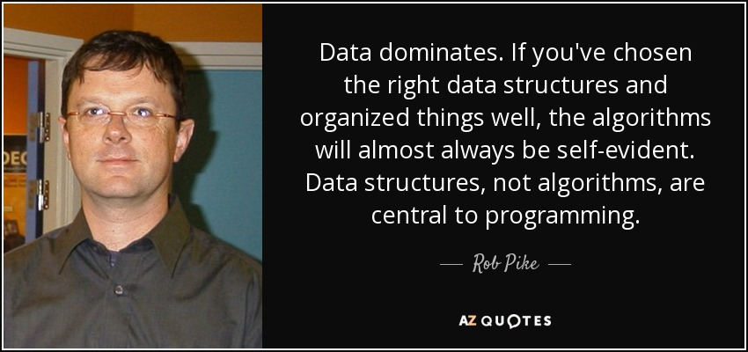
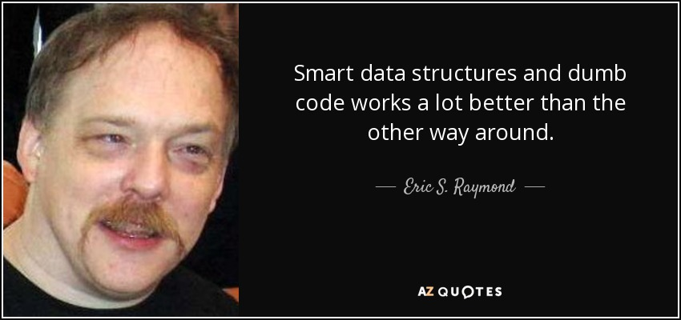
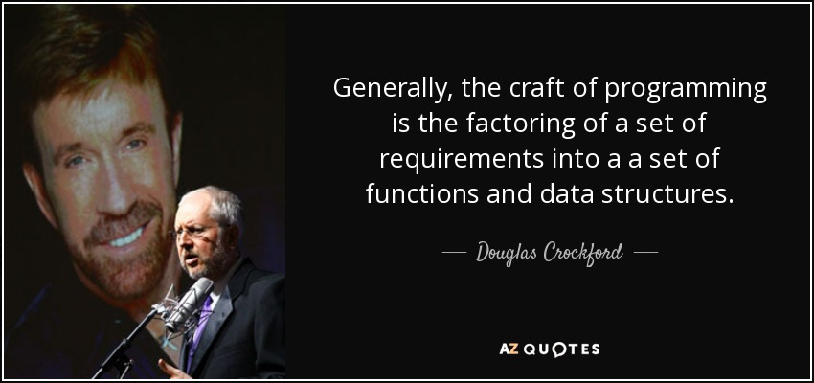
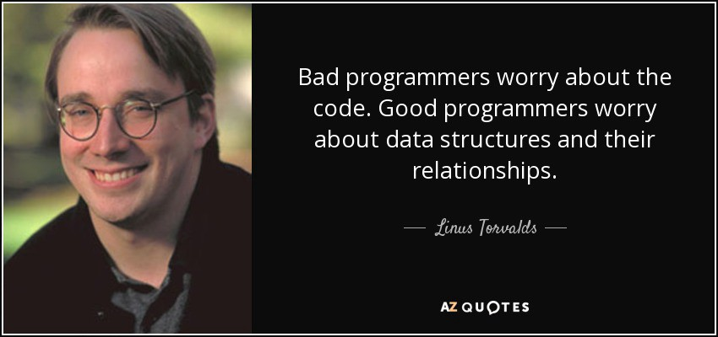
Why should you take up this course?
That’s what they said about data structures

Slide 7
Topics to be covered in this course
Data Structures with C++
Pointers and References
Arrays
Linked Lists
Stacks and Queues
Graph
Binary Trees
Heap & Priority Queue
Sorting
Searching

Slide 8
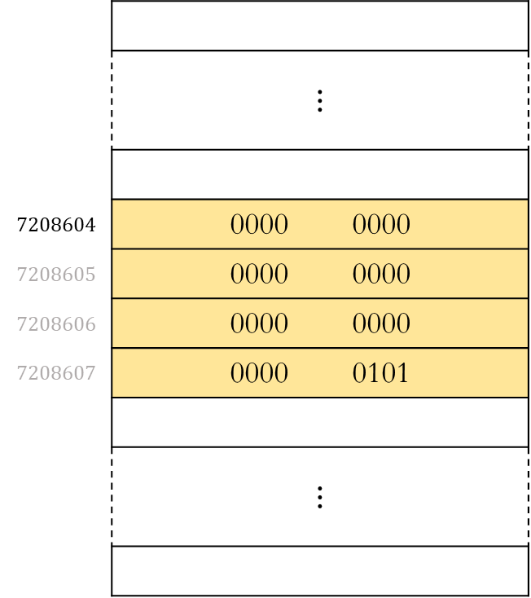

Topics to be covered in this course
Data Structures with C++
Pointers and References
Introduction to Pointers and References
const pointer, const reference, const function
Passing argument by value, pointer and reference

Slide 9

Topics to be covered in this course
Data Structures with C++
Arrays
Introduction to Arrays
Row major and column major representation of Arrays
⋮
a[0]
a[1]
a[2]
a[3]
a[4]
⋮

Slide 10

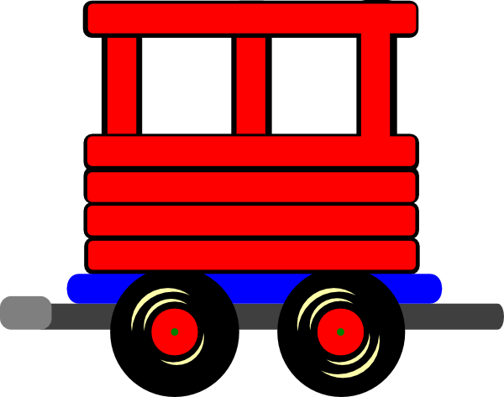
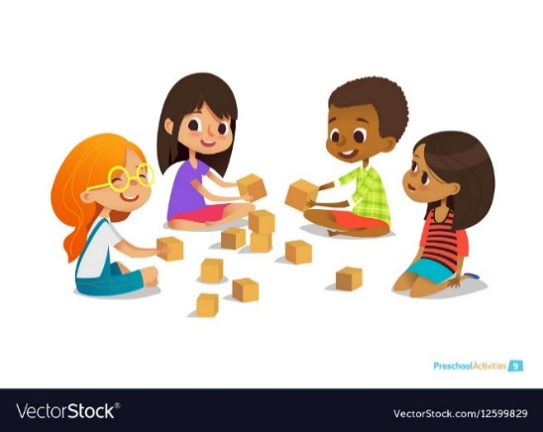

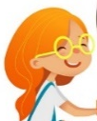


Topics to be covered in this course
Data Structures with C++
Linked Lists
Introduction to Linked Lists
Inserting an element
Deleting an element
Reversing a linked list
Doubly linked lists
Circularly linked lists
Application of linked lists
Linked Express
III
II
I

Slide 11
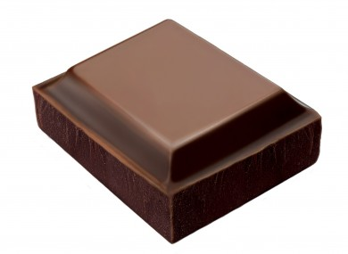

Topics to be covered in this course
Data Structures with C++
Stacks and Queues
Stack using array
Stack using linked list
Application of Stack - infix to postfix
Application of Stack - postfix evaluation
Queue using array
Queue using linked list
top
top
top
top

Slide 12
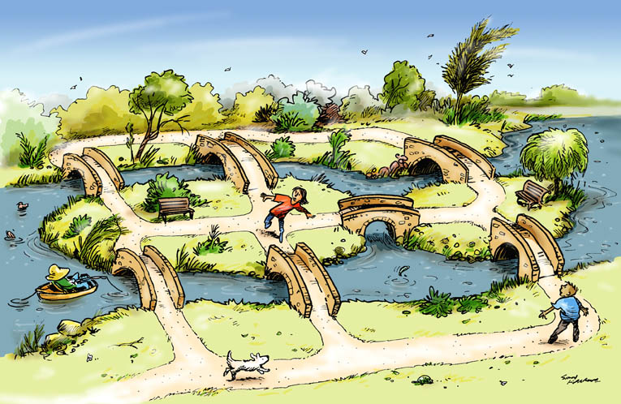
Topics to be covered in this course
Data Structures with C++
Graph
Adjacency Matrix and Adjacency List representations
Reading a graph from a file
Breadth First Search
Depth First Search

Slide 13
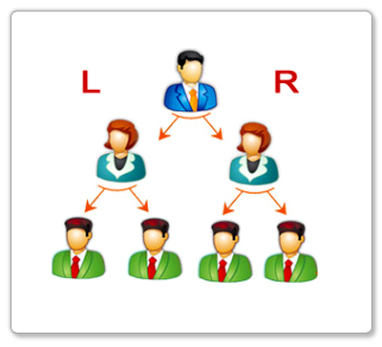
Topics to be covered in this course
Data Structures with C++
Binary Trees
Binary Tree
Binary Tree Traversal
Implementation of Binary Tree
Binary Search Tree
Implementation of Binary Search Tree
Red Black Tree
Red Black Tree Implementation
AVL Tree
AVL Tree Implementation

Slide 14



Topics to be covered in this course
Data Structures with C++
Heap & Priority Queue
Heap
Heap Sort
Priority Queue
Out of my way. I am in a hurry
PRIORITY

Slide 15

Topics to be covered in this course
Data Structures with C++
Sorting
Selection Sort
Insertion Sort
Bubble Sort
Quick Sort
Merge Sort
Radix Sort

Slide 16
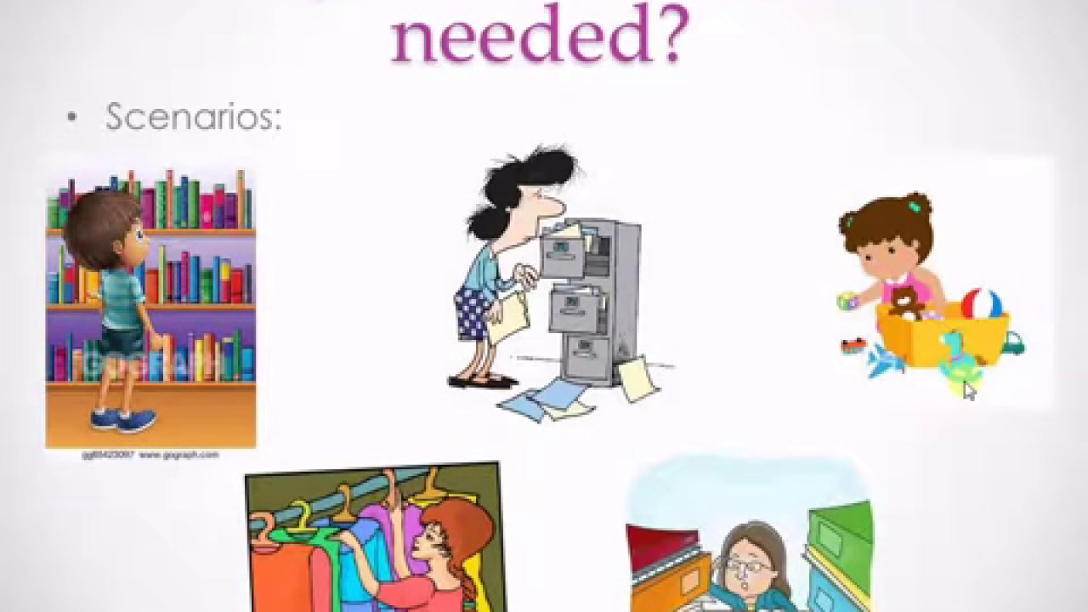
Topics to be covered in this course
Data Structures with C++
Searching
Linear Search
Binary Search
Interpolation Search
Hashing

Slide 17
What will you learn from this course?
At the end of this course you will be able to:
Apply features of c++ such as pointers, references, arrays, classes, templates, function overloading, virtual functions, exception handling etc. in building robust data structures
Understand the nuances of object oriented programming, e.g. abstraction, encapsulation, polymorphism, inheritance etc.
Conceptualize the idea of basic data structures, viz. linked lists, stacks, queues, graphs, binary trees, heaps, binary search trees, AVL trees, red black trees etc.
Implement the basic as well as your own (more complex) data structures in c++
Recognize various techniques of sorting a collection and develop them in c++
Search for something in a collection
Solve problems related to data structures using the tools and techniques of c++

Slide 18


